Slide 1
Software Project Management

Slide 2
Introduction
Many software projects fail:
  due to faulty project management practices:
    It is important to learn different aspects of software project management.

Slide 3
Introduction
Goal of software project management:
  enable a group of engineers to work efficiently towards successful completion of a software project.

Slide 4
Responsibility of project managers
Project proposal writing,
Project cost estimation,
Scheduling,
Project staffing,
Project monitoring and control,
Software configuration management,
Risk management,
Managerial report writing and presentations, etc.

Slide 5
Question
What are the necessary skills a project manager should have?
Knowledge of project management techniques
Decision taking capabilities.
Previous experience in managing similar projects.
All of above

Slide 6
Introduction
A project manager’s activities are varied.
  can be broadly classified into:
    project planning,
    project monitoring and control activities.

Slide 7
Project Planning
Once a project is found to be feasible,
  project managers undertake project planning.

Slide 8
Project Planning Activities
Estimation:
  Effort, cost, resource, and project duration
Project scheduling:
Staff organization:
  staffing plans
Risk handling:
  identification, analysis, and abatement procedures
Miscellaneous plans:
  quality assurance plan, configuration management plan, etc.

Slide 9
Project planning
Requires utmost care and attention --- commitments to unrealistic time and resource estimates result in:
  irritating delays.
  customer dissatisfaction
  adverse affect on team morale
    poor quality work
  project failure.

Slide 10
Sliding Window Planning
Involves project planning over several stages:
  protects managers from making big commitments too early.
  More information becomes available as project progresses.
    Facilitates accurate planning

Slide 11
SPMP Document
After planning is complete:
  Document the plans:
  in a Software Project Management Plan(SPMP) document.

Slide 12
Organization of SPMP Document
  Introduction (Objectives,Major Functions,Performance Issues,Management and Technical Constraints)
  Project Estimates (Historical Data,Estimation Techniques,Effort, Cost, and Project Duration Estimates)
  Project Resources Plan (People,Hardware and Software,Special Resources)
  Schedules (Work Breakdown Structure,Task Network, Gantt Chart Representation,PERT Chart Representation)
  Risk Management Plan (Risk Analysis,Risk Identification,Risk Estimation, Abatement Procedures)
  Project Tracking and Control Plan
  Miscellaneous Plans(Process Tailoring,Quality Assurance)

Slide 13
Question
Which technique is used to plan the project is several stages?
Project estimation planning
Sliding window planning
Project Documentation Plan
None of above

Slide 14
Software Cost Estimation
Determine size of the product.
From the size estimate,
  determine the effort needed.
From the effort estimate,
  determine project duration, and cost.

Slide 15
Software Cost Estimation
Effort Estimation
Cost Estimation
Size Estimation
Staffing Estimation
Duration Estimation
Scheduling

Slide 16
Software Size Metrics
LOC (Lines of Code):
  Simplest and most widely used metric.
  Comments and blank lines should not be counted.

Slide 17
Disadvantages of Using LOC
Size can vary with coding style.
Focuses on coding activity alone.
Correlates poorly with quality and efficiency of code.
Penalizes higher level programming languages, code reuse, etc.

Slide 18
Disadvantages of Using LOC (cont...)
Measures lexical/textual complexity only.
  does not address the issues of structural or logical complexity.
Difficult to estimate LOC from problem description.
  So not useful for project planning

Slide 19
Function Point Metric
Overcomes some of the shortcomings of the LOC metric
Proposed by Albrecht in early 80’s:
The function point metric is based on the idea that a software product supporting many features would certainly be of larger size than a product with less number of features.

Slide 20
Function Point Metric
Input:
  A set of related inputs is counted as one input.
Output:
  A set of related outputs is counted as one output.
Inquiries:
  Each user query type is counted.
Files:
  Files are logically related data and thus can be data structures or physical files.
Interface:
  Data transfer to other systems.

Slide 21
Question
Which factor we have to evaluate first to estimate efforts of the software project?
Cost Estimation
Duration Estimation
Size Estimation
Staffing Estimation

Slide 22
Function point (FP) metric computation
Step 1: Compute the unadjusted function point (UFP) using a heuristic expression.
Step 2: Refine UFP to reflect the actual complexities of the different parameters used in UFP computation.
Step 3: Compute FP by further refining UFP to account for the specific characteristics of the project that can influence the entire development effort.

Slide 23
Step 1: UFP computation
The unadjusted function points (UFP) is computed as the weighted sum of five characteristics of a product as shown in the following expression.
UFP = (Number of inputs)*4 + (Number of outputs)*5 + (Number of inquiries)*4 + (Number of files)*10 + (Number of interfaces)*10

Slide 24
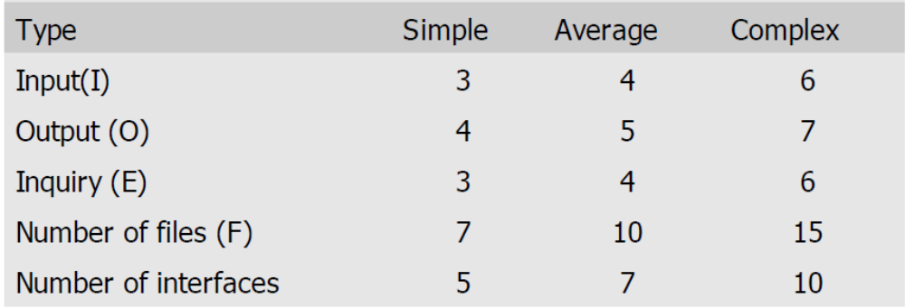
Step 2: Refine parameters
The complexity of each parameter is graded into three broad categories—simple, average, or complex.

Slide 25
Step 3: Refine UFP based on complexity of the overall project
Albrecht identified 14 parameters that can influence the development effort.
Each of these 14 parameters is assigned a value from 0 (not present or no influence) to 6 (strong influence).
The resulting numbers are summed, yielding the total degree of influence (DI).
DI = 14 * Average No. of influence
TCF (technical complexity factor) = (0.65+0.01*DI)
FP = UFP*TCF

Slide 26

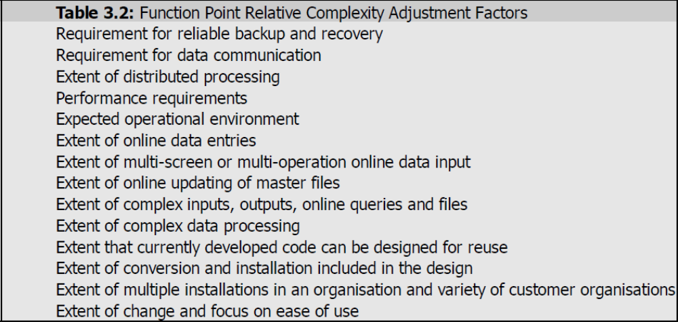
list of these Parameters

Slide 27
Question
How many steps are there to estimate the Function Point?
2
3
5
6

Slide 28
Example
Determine the function point measure of the size of the following supermarket software. A supermarket needs to develop the following software to encourage regular customers. For this, the customer needs to supply his/her residence address, telephone number, and the driving license number. Each customer who registers for this scheme is assigned a unique customer number (CN) by the computer. Based on the generated CN, a clerk manually prepares a customer identity card after getting the market manager’s signature on it. A customer can present his customer identity card to the check out staff when he makes any purchase. In this case, the value of his purchase is credited against his CN. At the end of each year, the supermarket intends to award surprise gifts to 10 customers who make the highest total purchase over the year. Also, it intends to award a 22 caret gold coin to every customer whose purchase exceeded Rs. 10,000. The entries against the CN are reset on the last day of every year after the prize winners’ lists are generated. Assume that various project characteristics determining the complexity of software development to be average.

Slide 29

Software Project Planning
Example: 4.1
Consider a project with the following functional units:
Number of user inputs = 50
Number of user outputs = 40
Number of user enquiries = 35
Number of user files = 06
Number of external interfaces = 04
Assume all complexity adjustment factors and weighting factors are average. Compute the function points for the project.

Slide 30
Function Point Metric (CONT.)
Suffers from a major drawback:
  the size of a function is considered to be independent of its complexity.
Extend function point metric:
  Feature Point metric:
  considers an extra parameter:
    Algorithm Complexity.

Slide 31
Function Point Metric (CONT.)
Proponents claim:
  FP is language independent.
  Size can be easily derived from problem description
Opponents claim:
  it is subjective --- Different people can come up with different estimates for the same problem.

Slide 32
Project Estimation Technique
Three main approaches to estimation:
  Empirical
  Heuristic
  Analytical

Slide 33
Project Estimation Technique
Empirical techniques:
  an educated guess based on past experience.
Heuristic techniques:
  assume that the characteristics to be estimated can be expressed in terms of
  some mathematical expression.
Analytical techniques:
  derive the required results starting from certain simple assumptions.

Slide 34
Empirical Size Estimation Techniques
Expert Judgement:
  An euphemism for guess made by an expert.
  Suffers from individual bias.
Delphi Estimation:
  overcomes some of the problems of expert judgement.

Slide 35
Expert judgement
Experts divide a software product into component units:
  e.g. GUI, database module, data communication module, billing module, etc.
Add up the guesses for each of the components.

Slide 36
Delphi Estimation:
Team of Experts and a coordinator.
Experts carry out estimation independently:
  mention the rationale behind their estimation.
  coordinator notes down any extraordinary rationale:
    circulates among experts.

Slide 37
Delphi Estimation:
Experts re-estimate.
Experts never meet each other
  to discuss their viewpoints.

Slide 38
Heuristic Estimation Techniques
Single Variable Model:
  Parameter to be Estimated=C1(Estimated Characteristic)d1
Multivariable Model:
  Assumes that the parameter to be estimated depends on more than one characteristic.
  Parameter to be Estimated=C1(Estimated Characteristic)d1+ C2(Estimated Characteristic)d2+…
  Usually more accurate than single variable models.

Slide 39
COCOMO Model
COCOMO (COnstructive COst MOdel) proposed by Boehm.
Divides software product developments into 3 categories:
  Organic
  Semidetached
  Embedded

Slide 40
COCOMO Product classes
Roughly correspond to:
  application, utility and system programs respectively.
    Data processing and scientific programs are considered to be application programs.
    Compilers, linkers, editors, etc., are utility programs.
    Operating systems and real-time system programs, etc. are system programs.

Slide 41
Elaboration of Product classes
Organic:
  Relatively small groups
    working to develop well-understood applications.
Semidetached:
  Project team consists of a mixture of experienced and inexperienced staff.
Embedded:
  The software is strongly coupled to complex hardware, or real-time systems.

Slide 42
COCOMO Model (CONT.)
For each of the three product categories:
  From size estimation (in KLOC), Boehm provides equations to predict:
    project duration in months
    effort in programmer-months
Boehm obtained these equations:
  examined historical data collected from a large number of actual projects.

Slide 43
COCOMO Model (CONT.)
Software cost estimation is done through three stages:
  Basic COCOMO,
  Intermediate COCOMO,
  Complete COCOMO.

Slide 44
Basic COCOMO Model (CONT.)
Gives only an approximate estimation:
  Effort = a1*(KLOC)^{a2}
  Tdev = b1*(Effort)^{b2}
    KLOC is the estimated kilo lines of source code,
    a1,a2,b1,b2 are constants for different categories of software products,
    Tdev is the estimated time to develop the software in months,
    Effort estimation is obtained in terms of person months (PMs).

Slide 45
Development Effort Estimation
Organic :
  Effort = 2.4 (KLOC)^{1.05} PM
Semi-detached:
  Effort = 3.0(KLOC)^{1.12} PM
Embedded:
  Effort = 3.6 (KLOC)^{1.20} PM

Slide 46
Development Time Estimation
Organic:
  Tdev = 2.5 (Effort)^{0.38} Months
Semi-detached:
  Tdev = 2.5 (Effort)^{0.35} Months
Embedded:
  Tdev = 2.5 (Effort)^{0.32} Months

Slide 47
Basic COCOMO Model (CONT.)
Effort is somewhat super-linear in problem size.
Semidetached
Effort
Embedded
Organic
Size

Slide 48
Basic COCOMO Model (CONT.)
Development time
  sublinear function of product size.
When product size increases two times,
  development time does not double.
Time taken:
  almost same for all the three product categories.
Dev. Time
Embedded
Semidetached
18 Months
14 Months
Organic
30K
60K
Size

Slide 49
Basic COCOMO Model (CONT.)
Development time does not increase linearly with product size:
  For larger products more parallel activities can be identified:
    can be carried out simultaneously by a number of engineers.

Slide 50
Basic COCOMO Model (CONT.)
Development time is roughly the same for all the three categories of products:
  For example, a 60 KLOC program can be developed in approximately 18 months
    regardless of whether it is of organic, semi-detached, or embedded type.
  There is more scope for parallel activities for system and application programs,
    than utility programs.

Slide 51
Example
The size of an organic software product has been estimated to be 32,000 lines of source code.
Effort = 2.4*(32)^{1.05} = 91 PM
Nominal development time = 2.5*(91)^{0.38} = 14 months

Slide 52
Intermediate COCOMO
Basic COCOMO model assumes
  effort and development time depend on product size alone.
However, several parameters affect effort and development time:
    Reliability requirements
    Availability of CASE tools and modern facilities to the developers
    Size of data to be handled

Slide 53
Intermediate COCOMO
For accurate estimation,
  the effect of all relevant parameters must be considered:
  Intermediate COCOMO model recognizes this fact:
    refines the initial estimate obtained by the basic COCOMO by using a set of 15 cost drivers (multipliers).

Slide 54
Intermediate COCOMO (CONT.)
If modern programming practices are used,
  initial estimates are scaled downwards.
If there are stringent reliability requirements on the product :
  initial estimate is scaled upwards.

Slide 55
Intermediate COCOMO (CONT.)
Rate different parameters on a scale of one to three:
  Depending on these ratings,
    multiply cost driver values with the estimate obtained using the basic COCOMO.

Slide 56
Intermediate COCOMO (CONT.)
Cost driver classes:
  Product: Inherent complexity of the product, reliability requirements of the product, etc.
  Computer: Execution time, storage requirements, etc.
  Personnel: Experience of personnel, etc.
  Development Environment: Sophistication of the tools used for software development.

Slide 57
Intermediate COCOMO (CONT.)
(i) Product attributes –
Required software reliability extent
Size of the application database
The complexity of the product
(ii) Hardware attributes –
Run-time performance constraints
Memory constraints
The volatility of the virtual machine environment
Required turnabout time

Slide 58
Intermediate COCOMO (CONT.)
(iii) Personnel attributes –
Analyst capability
Software engineering capability
Applications experience
Virtual machine experience
Programming language experience
(iv) Project attributes –
Use of software tools
Application of software engineering methods
Required development schedule

Slide 59
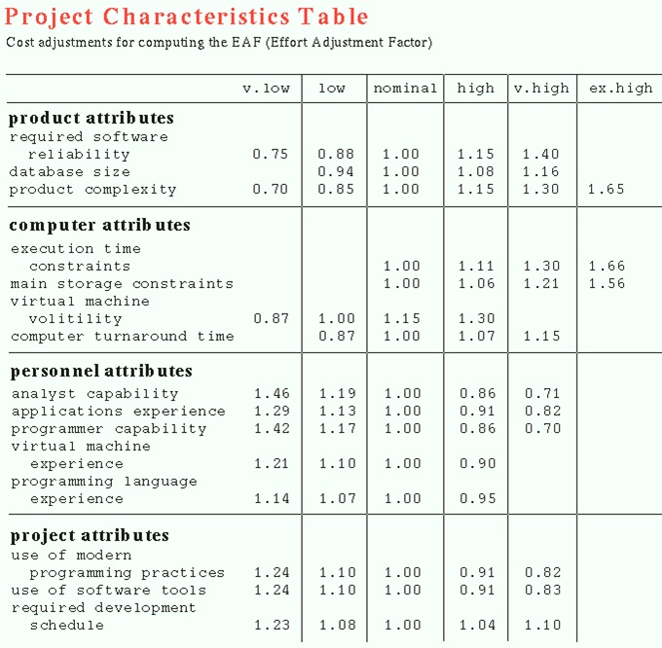

Slide 60
Example
The size of Microprocessor communication software product has been estimated to be 52,000 lines of source code.
Calculate Efforts?

Slide 61
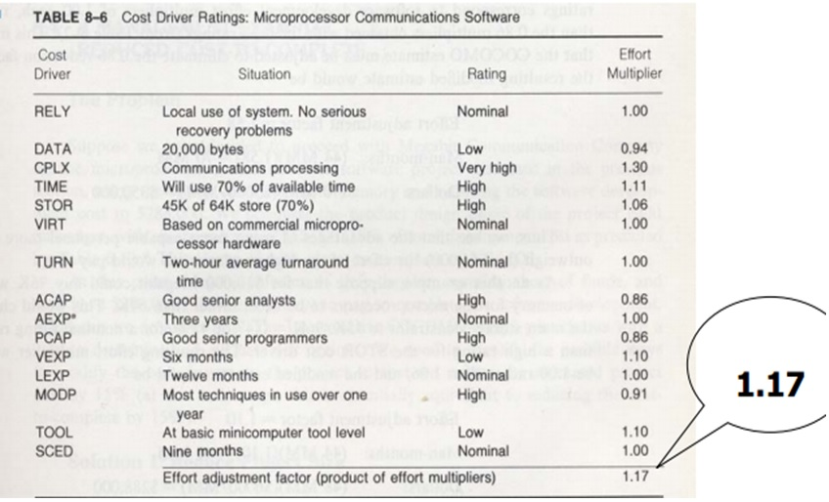

Slide 62
Shortcoming of basic and intermediate COCOMO models
Both models:
  consider a software product as a single homogeneous entity:
  However, most large systems are made up of several smaller sub-systems.
    Some sub-systems may be considered as organic type, some may be considered embedded, etc.
    for some the reliability requirements may be high, and so on.

Slide 63
Complete COCOMO
Cost of each sub-system is estimated separately.
Costs of the sub-systems are added to obtain total cost.
Reduces the margin of error in the final estimate.

Slide 64
Complete COCOMO Example
A Management Information System (MIS) for an organization having offices at several places across the country:
  Database part (semi-detached)
  Graphical User Interface (GUI) part (organic)
  Communication part (embedded)
Costs of the components are estimated separately:
  summed up to give the overall cost of the system.

Slide 65
Question
The size of software product has been estimated to be 82,000 lines of source code and effort adjustment factor is 2.41
Calculate Efforts?

Slide 66
Staffing Level Estimation
Number of personnel required during any development project:
  not constant.
Norden in 1958 analyzed many R&D projects, and observed:
  Rayleigh curve represents the number of full-time personnel required at any time.

Slide 67
Rayleigh Curve
Rayleigh curve is specified by two parameters:
  td the time at which the curve reaches its maximum
  K the total area under the curve.
L=f(K, td)
Rayleigh Curve
Effort
td
Time

Slide 68
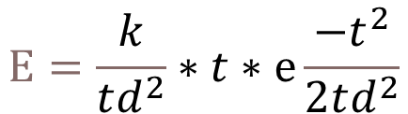
Norden represented the Rayleigh curve by the following equation:
E is the effort required at time t. E is an indication of the number of engineers (or the staffing level) at any particular time during the duration of the project
K is the area under the curve, and
td is the time at which the curve attains its maximum value.

Slide 69
Putnam’s Work:
In 1976, Putnam studied the problem of staffing of software projects:
  observed that the level of effort required in software development efforts has a similar envelope.
  found that the Rayleigh-Norden curve
    relates the number of delivered lines of code to effort and development time.

Slide 70
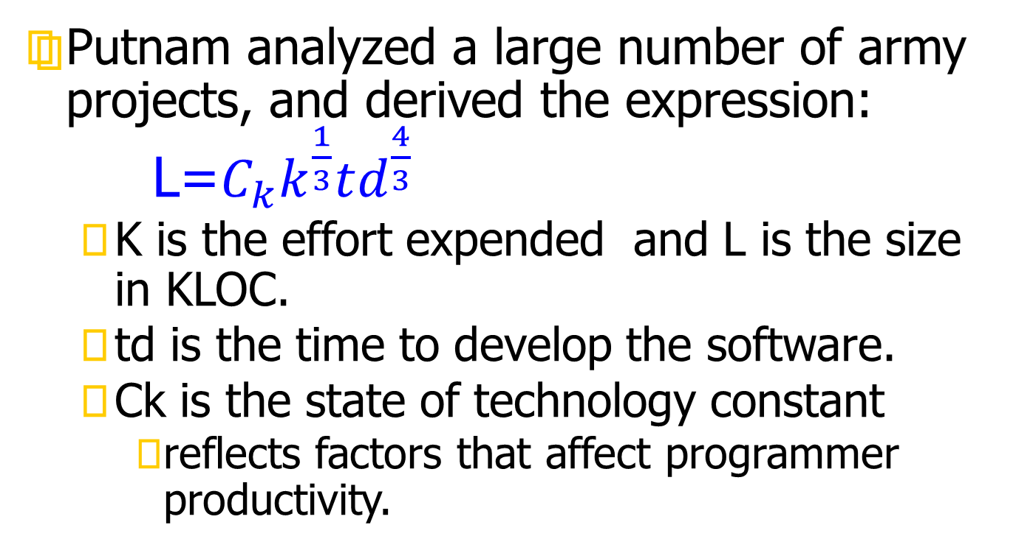
Putnam’s Work (CONT.):

Slide 71
Putnam’s Work (CONT.):
Ck=2 for poor development environment
  no methodology, poor documentation, and review, etc.
Ck=8 for good software development environment
  software engineering principles used
Ck=11 for an excellent environment

Slide 72
Rayleigh Curve
Very small number of engineers are needed at the beginning of a project
  carry out planning and specification.
As the project progresses:
  more detailed work is required,
  number of engineers slowly increases and reaches a peak.

Slide 73
Rayleigh Curve
Putnam observed that:
  the time at which the Rayleigh curve reaches its maximum value
    corresponds to system testing and product release.
  After system testing,
    the number of project staff falls till product installation and delivery.

Slide 74
Rayleigh Curve
From the Rayleigh curve observe that:
  approximately 40% of the area under the Rayleigh curve is to the left of td
  and 60% to the right.

Slide 75
Effect of Schedule Change on Cost
Using the Putnam's expression for L,
K=L³/(Ck^{3 *} td⁴⁾
Or, K=C/td⁴
For the same product size, C=L³/Ck³ is a constant.
Or, K₁/K₂ = td₂⁴/td₁⁴

Slide 76
Effect of Schedule Change on Cost (CONT.)
Observe:
  a relatively small compression in delivery schedule
    can result in substantial penalty on human effort.
Also, observe:
  benefits can be gained by using fewer people over a somewhat longer time span.

Slide 77
Example
If the estimated development time is 1 year, then in order to develop the product in 6 months,
  the total effort and hence the cost increases 16 times.
  In other words,
    the relationship between effort and the chronological delivery time is highly nonlinear.

Slide 78
Example
The nominal effort and duration of a project have been estimated to be 1000PM and 15 months. The project cost has been negotiated to be Rs. 200,000,000. The needs the product to be developed and delivered in 12 month time. What should be the new cost to be negotiated?

Slide 79
Effect of Schedule Change on Cost (CONT.)
Putnam model indicates extreme penalty for schedule compression
  and extreme reward for expanding the schedule.
Putnam estimation model works reasonably well for very large systems,
  but seriously overestimates the effort for medium and small systems.

Slide 80
Effect of Schedule Change on Cost (CONT.)
Boehm observed:
  “There is a limit beyond which the schedule of a software project cannot be reduced by buying any more personnel or equipment.”
  This limit occurs roughly at 75% of the nominal time estimate.

Slide 81
Effect of Schedule Change on Cost (CONT.)
If a project manager accepts a customer demand to compress the development time by more than 25%
  very unlikely to succeed.
    every project has only a limited amount of parallel activities
    sequential activities cannot be speeded up by hiring any number of additional engineers.
    many engineers have to sit idle.

Slide 82
Example
The nominal effort and duration of a project have been estimated to be 15000PM and 54 months. The project cost has been negotiated to be Rs. 400,000,000. The needs the product to be developed and delivered in 40 month time. What should be the new cost to be negotiated?

Slide 83
Project scheduling
It involves deciding which tasks would be taken up when. Activities undertaken:
1. Identify all the tasks needed to complete the project.
2. Break down large tasks into small activities.
3. Determine the dependency among different activities.
4. Establish the most likely estimates for the time durations necessary to complete the activities.
5. Allocate resources to activities.
6. Plan the starting and ending dates for various activities.
7. Determine the critical path. A critical path is the chain of activities that determines the duration of the project.

Slide 84
Work breakdown structure
Work Breakdown Structure (WBS) is used to decompose a given task set recursively into small activities.
The root of the tree is labelled by the problem name.
Each node of the tree is broken down into smaller activities that are made the children of the node.
Each activity is recursively decomposed into smaller sub-activities until at the leaf level, the activities requires approximately two weeks to develop.

Slide 85
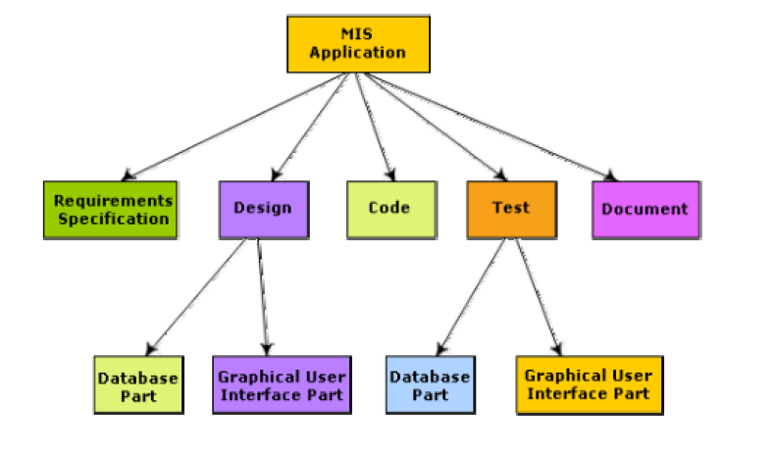
Work breakdown structure of MIS problem

Slide 86
Activity networks and critical path method
WBS representation of a project is transformed into an activity network by representing activities identified in WBS along with their interdependencies.
An activity network shows the different activities making up a project, their estimated durations, and interdependencies.

Slide 87
Activity network representation of the MIS problem
Activity | Predecessor Activity | Duration (Days)
Specification | - | 15
Design Database | Specification | 45
Design GUI Part | Specification | 30
Write User Manual | Specification | 60
Code Database | Design Database | 105
Code GUI Part | Design GUI Part | 45
Integration Test | Code Database, Code GUI Part | 120
Finish | Integration Test, Write User Manual | 0

Slide 88
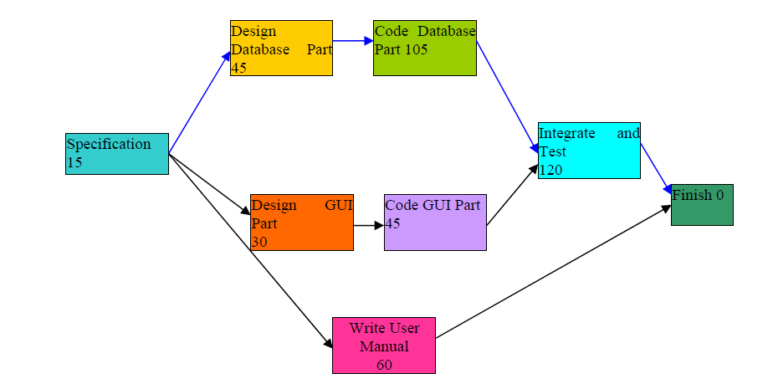
Activity network representation of the MIS problem

Slide 89
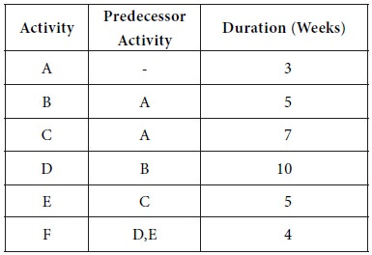
Example

Slide 90
Critical Path Method (CPM)
The minimum time (MT) to complete the project is the maximum of all paths from start to finish.
The earliest start (ES) time of a task is the maximum of all paths from the start to the task.
The latest start time is the difference between MT and the maximum of all paths from this task to the finish.
The earliest finish time (EF) of a task is the sum of the earliest start time of the task and the duration of the task.
The latest finish (LF) time of a task can be obtained by subtracting maximum of all paths from this task to finish from MT.
The slack time (ST) is LS – EF and equivalently can be written as LF – EF.

Slide 91
Slack Time
The slack time (or float time) is the total time that a task may be delayed before it will affect the end time of the project.
The slack time indicates the “flexibility” in starting and completion of tasks.
A critical task is one with a zero slack time. A path from the start node to the finish node containing only critical tasks is called a critical path.

Slide 92
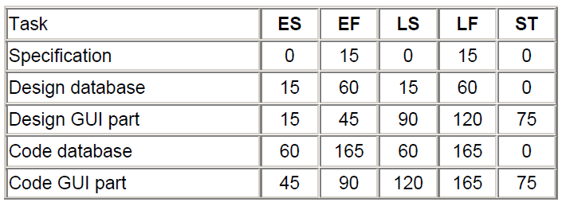

Parameters for different tasks of MIS Problem

Slide 93
Question
What is slack time?
a: Total time that a task may be delayed before it will affect the end time of the project.
B: The maximum of all paths from start to finish
C: The difference between MT and the maximum of all paths from this task to the finish
D: The sum of the earliest start time of the task and the duration of the task

Slide 94
CPM graph Example
Activity | Predecessor | Duration (in months)
A | - | 5
B | A | 4
C | A | 5
D | B | 6
E | C | 3
F | D,E | 4

Slide 95
CPM graph
B
D
Start
F
Finish
A
C
E

Slide 96
Critical Path Calculation
ES | MT (D) | EF
 | Activity
LS | SL | LF
ES : Earliest start time
MT(D): Maximum Time/Duration
EF : Earliest Finish Time
LS: Latest Start Time
SL: Slack Time
LF: Latest Finish Time
Activity : Critical activity of the project.
Formulae:
EF = ES + D
SL = LF – EF
LS = LF – MT (D)
ES = Predecessor’s EF
LF = successor’s LS

Slide 97
0 | 5 | 5
 | A
5 | 4 | 9
 | B
5 | 5 | 10
 | C
9 | 6 | 15
 | D
10 | 3 | 13
 | E
15 | 4 | 19
 | F

Slide 98
SL = LF – EF
LS = LF – D
Start calculation from the finish (last) activity = F
15 | 4 | 19
 | F
15 | 0 | 19
10 | 3 | 13
 | E
12 | 2 | 15
9 | 6 | 15
 | D
9 | 0 | 15
5 | 5 | 10
 | C
7 | 2 | 12
5 | 4 | 9
 | B
5 | 0 | 9
0 | 5 | 5
 | A
0 | 0 | 5

Slide 99
Critical Paths
From the given example, we have 2 paths:
A->B->D->F
A->C->E->F
B
D
Start
F
Finish
A
C
E

Slide 100
Critical Paths contd
However, a critical path is the one which has 0 Slack Time (SL)
Therefore, out of the two paths,
A->B->D->F path has 0 slack time.
0 | 5 | 5
 | A
0 | 0 | 5
5 | 4 | 9
 | B
5 | 0 | 9
9 | 6 | 15
 | D
9 | 0 | 15
15 | 4 | 19
 | F
15 | 0 | 19

Slide 101
CPM Table:
Activity | ES | MT (D) | EF | LS | SL | LF
A | 0 | 5 | 5 | 0 | 0 | 5
B | 5 | 4 | 9 | 5 | 0 | 9
C | 5 | 5 | 10 | 7 | 2 | 12
D | 9 | 6 | 15 | 9 | 0 | 15
E | 10 | 3 | 13 | 12 | 2 | 15
F | 15 | 4 | 19 | 15 | 0 | 19

Slide 102
Gantt chart
Used to allocate resources to activities (resource planning).
The resources allocated to activities include staff, hardware, and software.
A Gantt chart is a special type of bar chart where each bar represents an activity.
The bars are drawn along a time line.
The length of each bar is proportional to the duration of time planned for the corresponding activity.

Slide 103
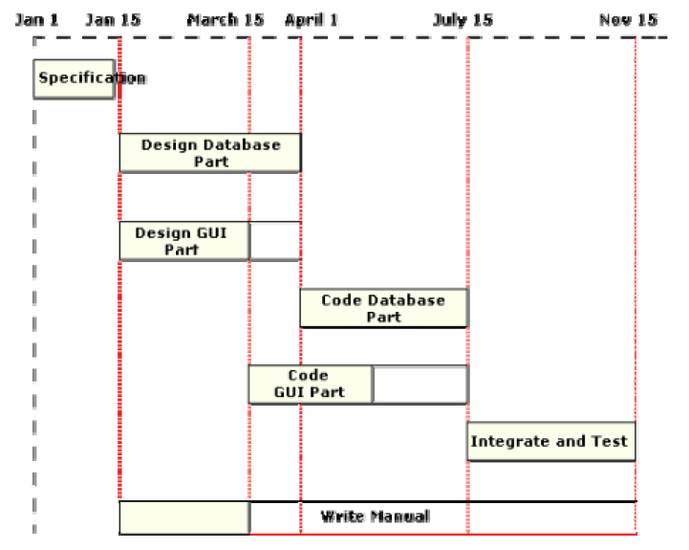
Gantt chart for MIS problem

Slide 104
PERT chart
PERT (Program Evaluation and Review Technique) charts consist of a network of boxes and arrows.
The boxes represent activities and the arrows represent task dependencies.
The boxes of PERT charts are usually annotated with the pessimistic, likely, and optimistic estimates for every task.

Slide 105
Gantt chart representation of a project schedule is helpful in planning the utilization of resources, while PERT chart is useful for monitoring the timely progress of activities.
Also, it is easier to identify parallel activities in a project using a PERT chart.

Slide 106
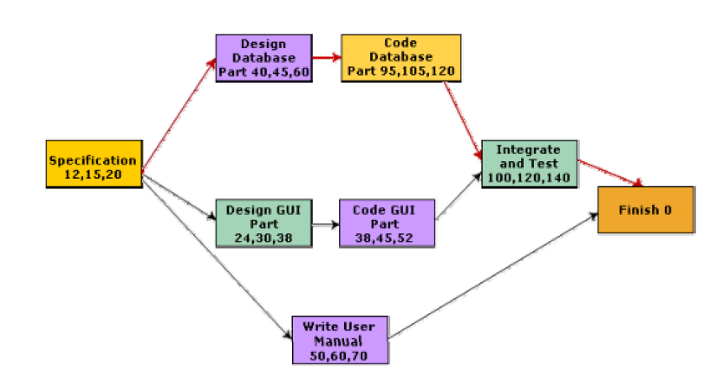
PERT chart representation of the MIS problem

